Slide 1
Data from Census Tables
Geocoding
Notes:
Before Start:
- Handout – syllabus
Turn up volume for scream effect
Open blank arcmap

Slide 2
Introduction to Census Data
The Census is taken every 10 Years and is a requirement of the Federal Government
The data determines a lot of important decisions such as;
Aid
Representation
Potential taxes (School Districts)
The data is provided in many different sizes

Slide 3
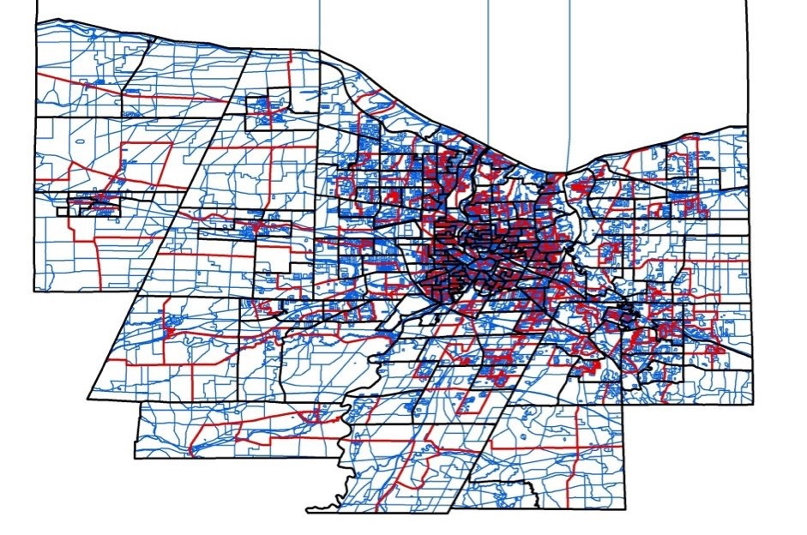
Census Data
Spatial (In Descending Size Order)
State
Division (County)
Town
Place
Tract
Block Group
Block
Blocks make up all of the information from each larger area
Tabular

Slide 4
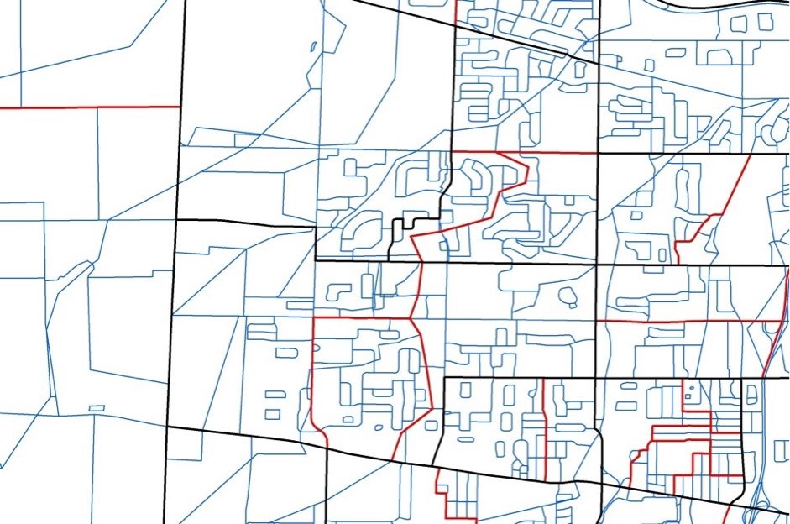
Census Data
Spatial (In Descending Size Order)
State
Division (County)
Town
Place
Tract
Block Group
Block
Blocks make up all of the information from each larger area
Tabular

Slide 5
Geographic Size Matters
Some Analysis need very detailed data (blocks) for small edits
Voting Districts
Block Groups are for slightly larger
Census Tracts are widely used for analysis due to their size and easy to report the data
Most grant projects report using the census tracts
The census data does not go to individual house level due to privacy concerns

Slide 6
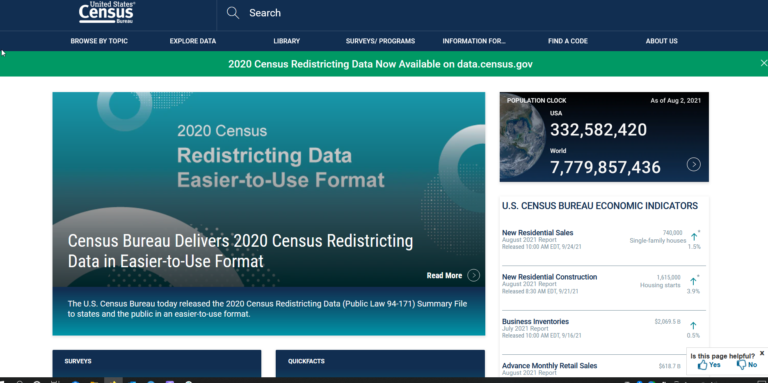
Census.gov

Slide 7
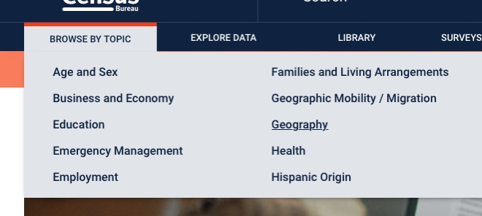
Geographic Data
The easiest way to find the geographic data is to browse by topic the geography

Slide 8
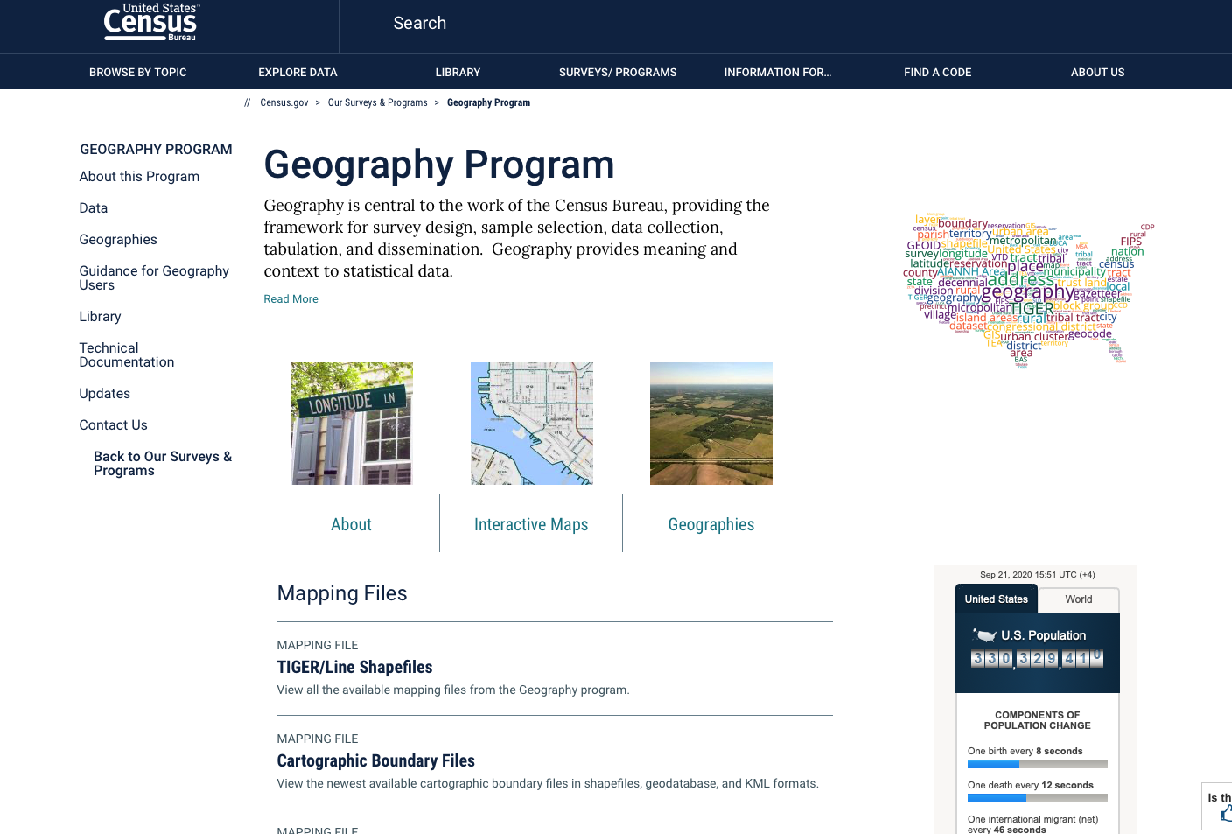
Geographic Data
The easiest way to find the geographic data is to browse by topic the geography
The geography program has lots of data
If you just want the line work shapefiles you can click that

Slide 9
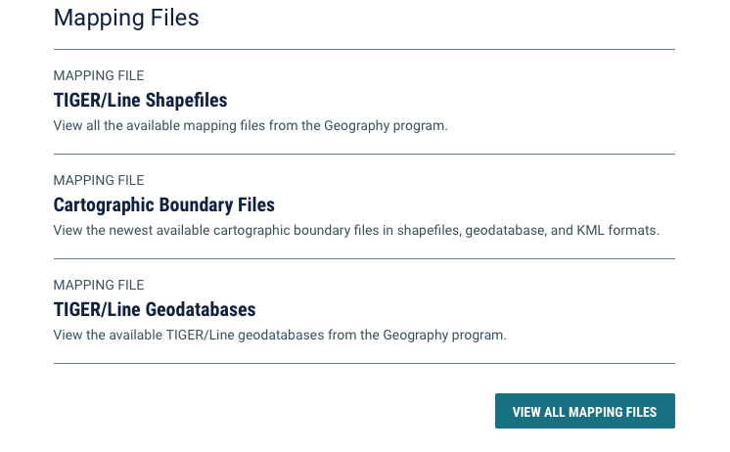
Geographic Data
The easiest way to find the geographic data is to browse by topic the geography
The geography program has lots of data
If you just want the line work shapefiles you can click that
If you click view all mapping files you will find a great dataset - TIGER/line Geodatabase with Select Demographic Data

Slide 10

Geographic Data
The easiest way to find the geographic data is to browse by topic the geography
The geography program has lots of data
If you just want the line work shapefiles you can click that
If you click view all mapping files you will find a great dataset - TIGER/line Geodatabase with Select Demographic and Economic Data (Note: this is the American Communities Survey or Long Form Census - Not all dates are available and the most current may be a year or two behind)
This has the same line work but with a lot of the data tables ~60,000 attributes and is easy to use.

Slide 11
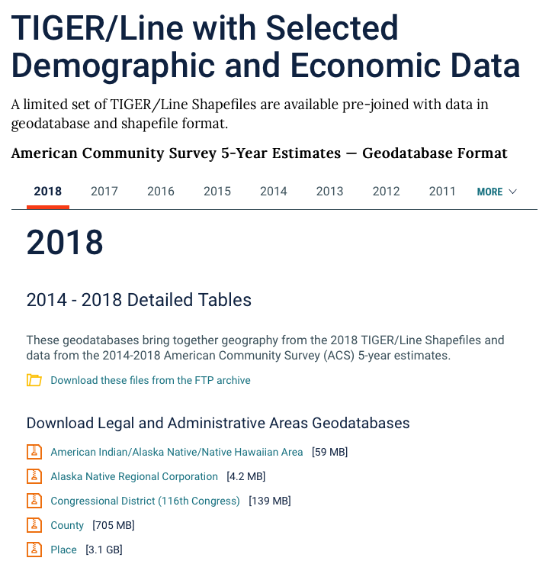
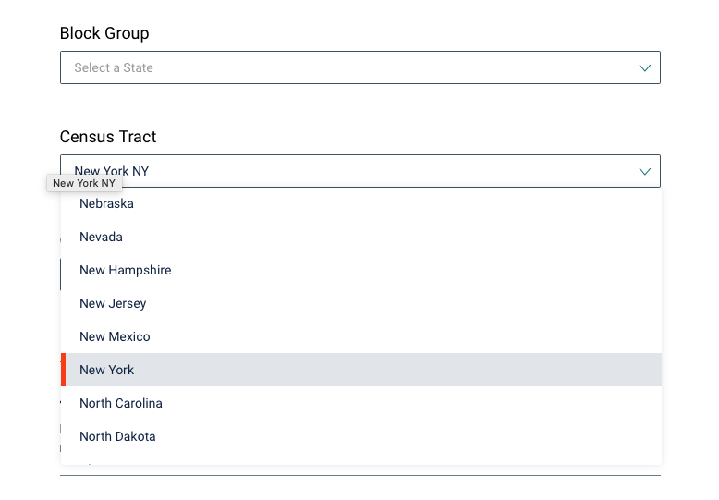
TIGER/line Geodatabase with Select Demographic and Economic Data

Slide 12
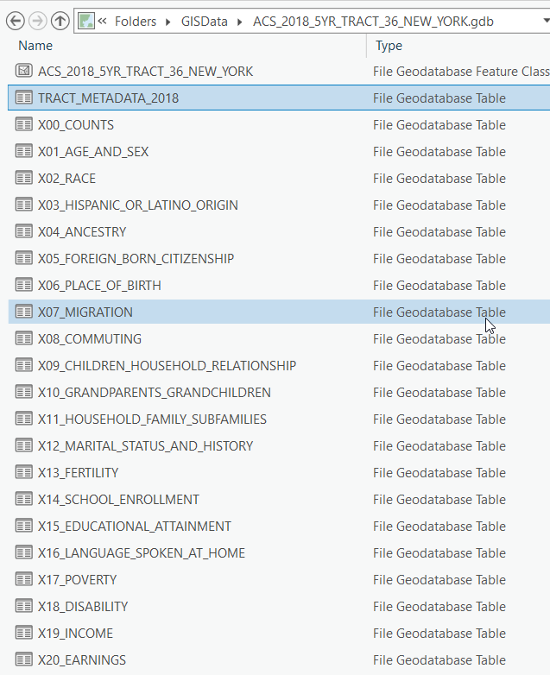
TIGER/line Geodatabase with Select Demographic and Economic Data
The Census Geodatabase has a ton of data
When you preview it using catalog you will see a single feature class and then a lot of tables
Each table is organized by theme
Previewing each table will show the data

Slide 13
TIGER/line Geodatabase with Select Demographic and Economic Data
The Census Geodatabase has a ton of data
When you preview it using catalog you will see a single feature class and then a lot of tables
Each table is organized by theme
Previewing each table will show the data
The metadata table is your guide to all of the attributes
I recommend exporting it to excel to make it easier to search

Slide 14
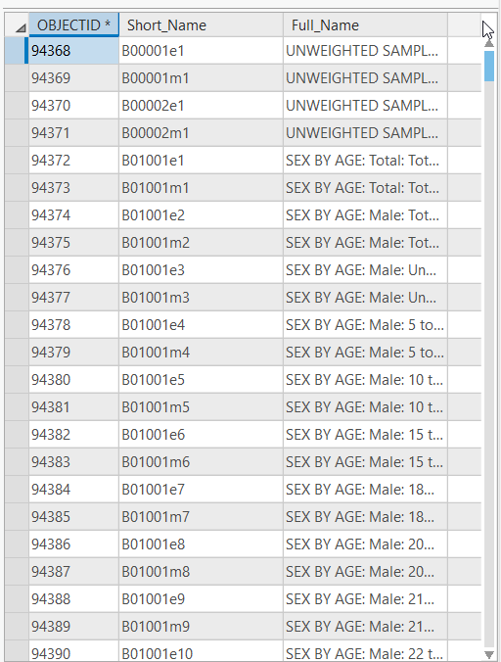
TIGER/line Geodatabase with Select Demographic and Economic Data
The Census Geodatabase has a ton of data
When you preview it using catalog you will see a single feature class and then a lot of tables
Each table is organized by theme
Previewing each table will show the data
The metadata table is your guide to all of the attributes
I recommend exporting it to excel to make it easier to search

Slide 15
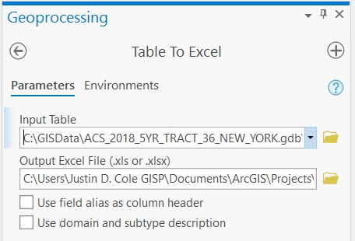
TIGER/line Geodatabase with Select Demographic and Economic Data
The Census Geodatabase has a ton of data
When you preview it using catalog you will see a single feature class and then a lot of tables
Each table is organized by theme
Previewing each table will show the data
The metadata table is your guide to all of the attributes
I recommend exporting it to excel to make it easier to search

Slide 16
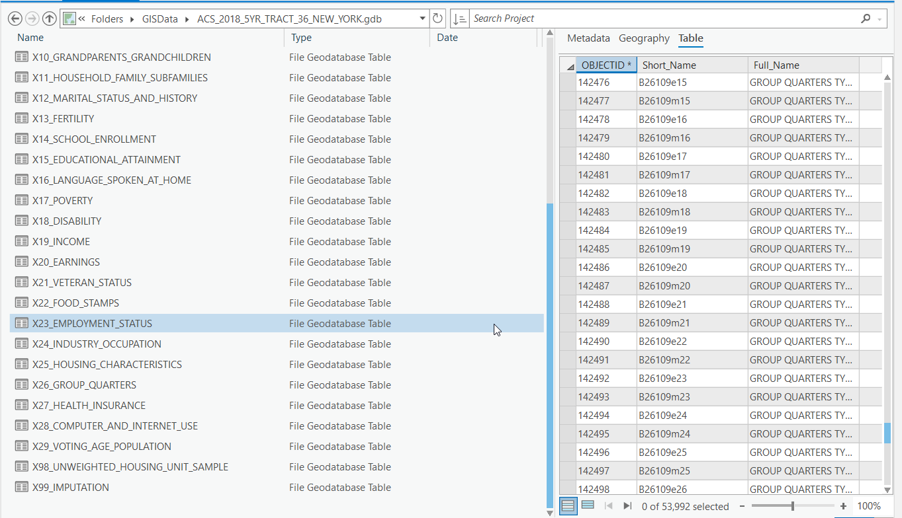
Tip - When Looking at the Metadata the 2 Digits after B is the same as the 2 digits after the X in the table name

Slide 17
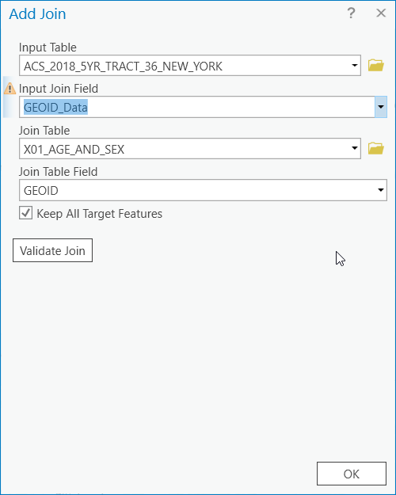
TIGER/line Geodatabase with Select Demographic and Economic Data
The Census Geodatabase has a ton of data
When you preview it using catalog you will see a single feature class and then a lot of tables
Each table is organized by theme
Previewing each table will show the data
The metadata table is your guide to all of the attributes
I recommend exporting it to excel to make it easier to search

Slide 18
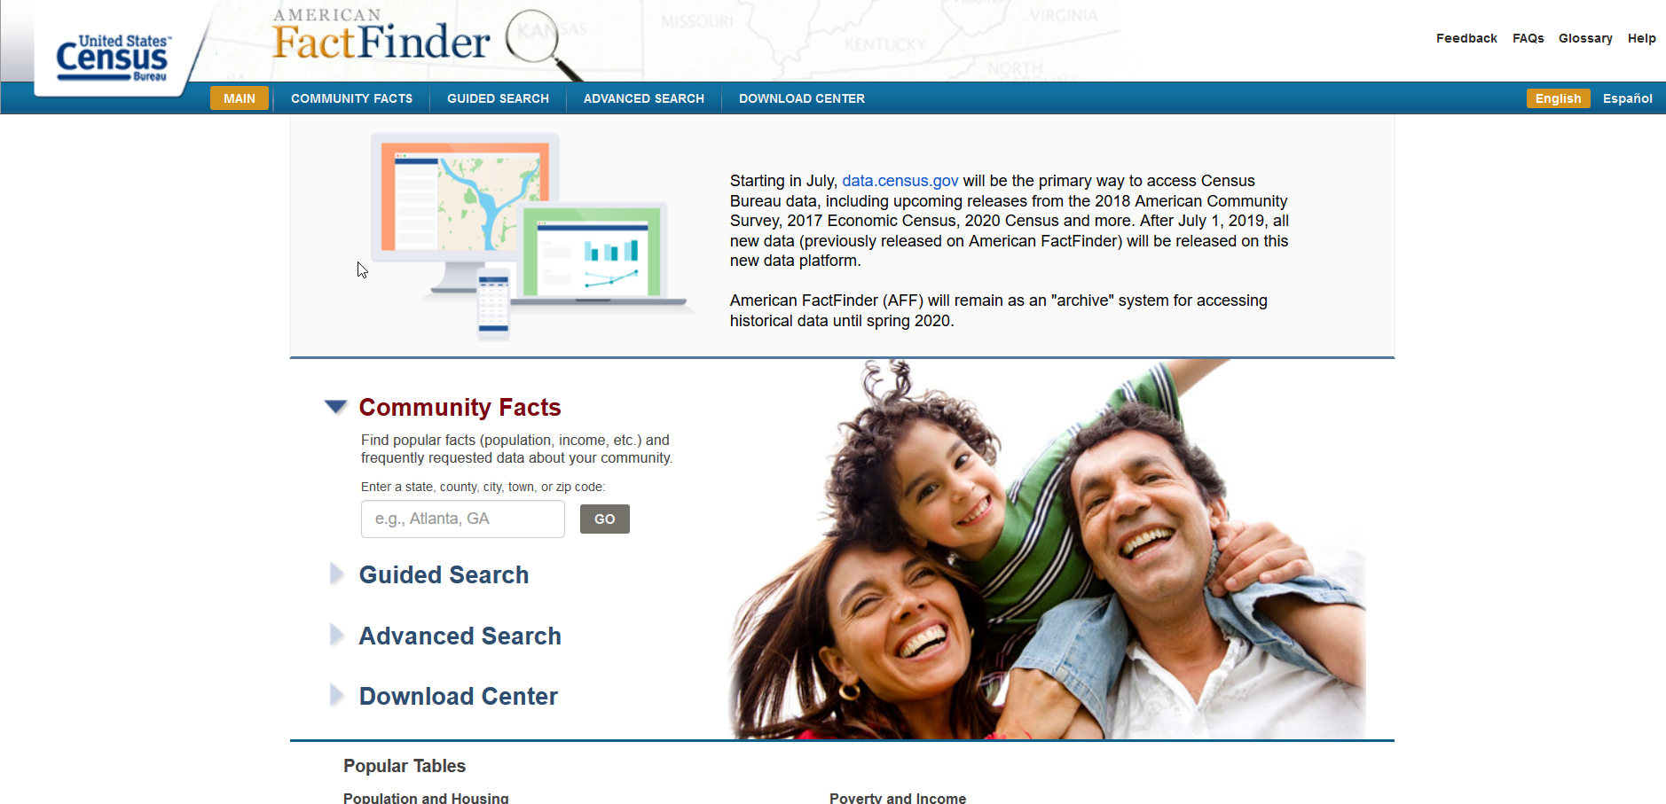
American Fact Finder

Slide 19
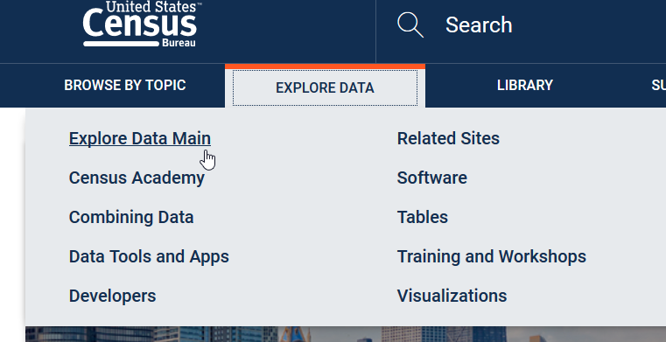
American FactFinder
Explore Data -> Explore Data Main

Slide 20
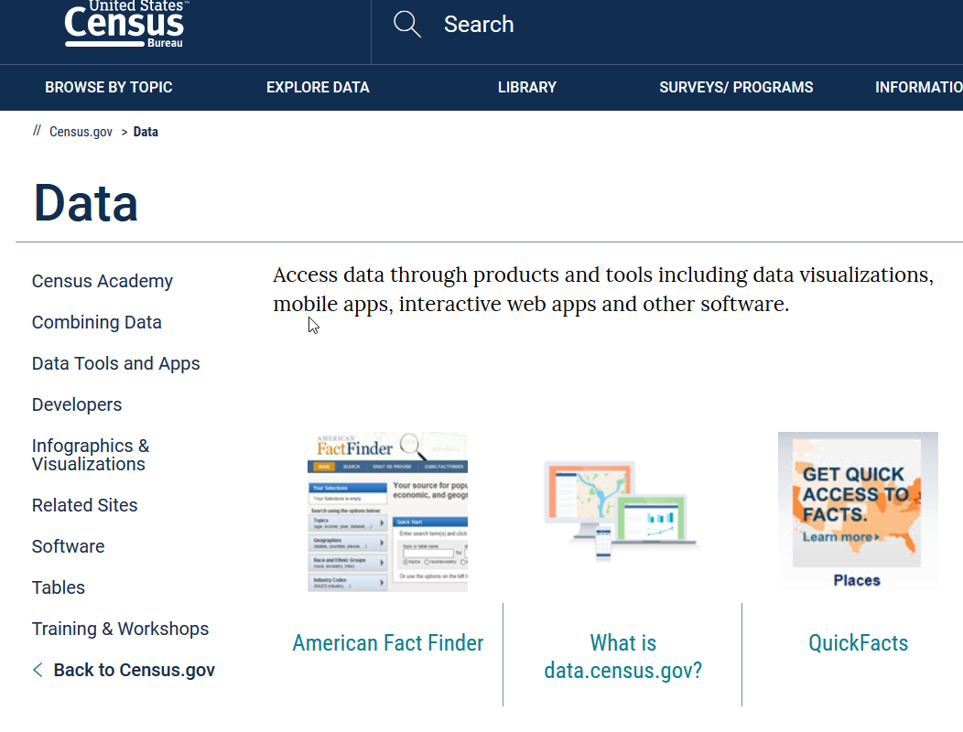
American FactFinder
Explore Data -> Explore Data Main
American Fact Finder

Slide 21
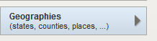
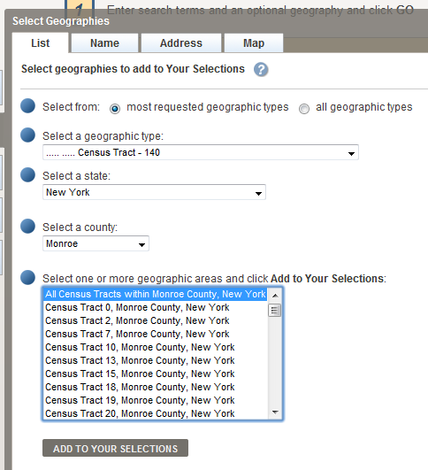
American FactFinder
Data -> American FactFinder
Advanced Search – Show Me All
Geographies
Census Tract
New York State
Monroe
All Census Tracts within
Add To Your Selections

Slide 22
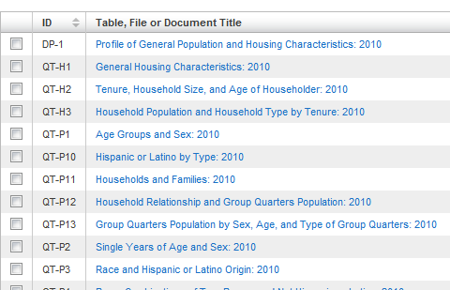
Pick Out Your Tables
I like the 2010 SF1 table DP-1 but you can pick what ever you want
Use the check box and click download
Download and then extract to your GIS folder
Close out of the web browser

Slide 23
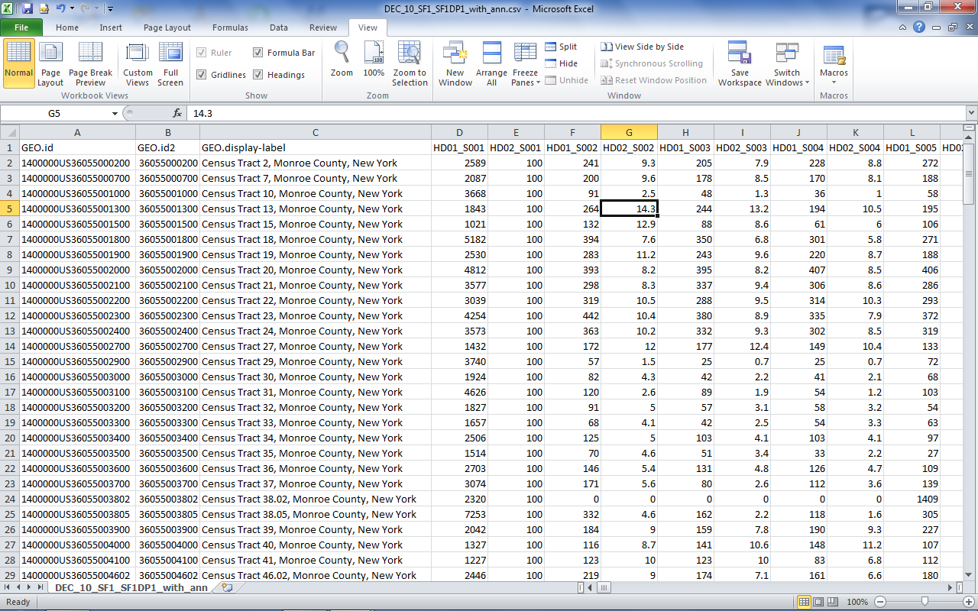
Open Your Table in Excel

Slide 24
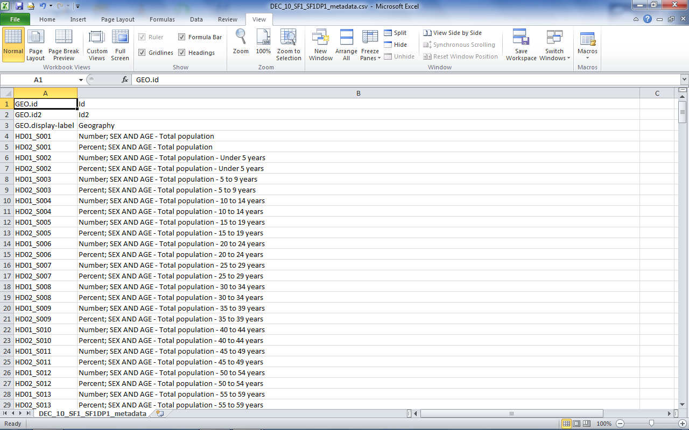
Open Your Table in Excel

Slide 25
Reformatting the Tables
Remove the . In Geo.ID, Geo.ID2 and GEO.display-label (esri does not allow for the . In field names)
Make Sure GeoID2 is a text field
Rename fields if you choose
Names are inside of the metadata csv
No spaces
Cannot lead with a number
Save it out as a .xlsx, dbf, or csv file

Slide 26
Census Tract Information
View in ArcGIS Pro
Census Tract Info
Table from Census Bureau
Open Attribute Table
Look for common fields

Slide 27
Hands on Demo with the Census Tracts

Slide 28
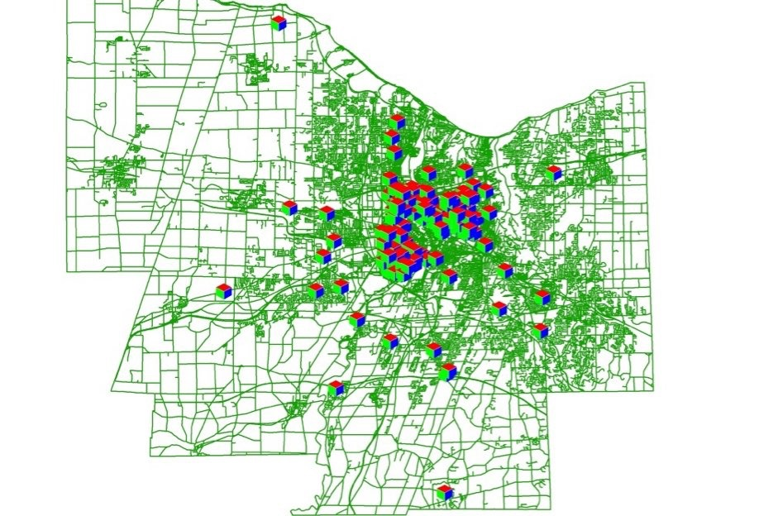
Geocoding
Geocoding is taking a table of addresses and placing them on the map
You need 3 things to geocode properly
Reference Data
Table to Geocode
Address Lookup (Index File)
Our Reference Data is going to be centerlines

Slide 29
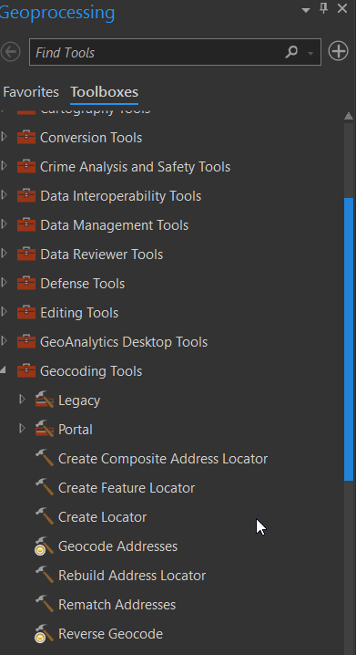
Creating an Address Locater
In ArcGIS Pro open Geoprocessing
Search or Browse for Create Locator

Slide 30
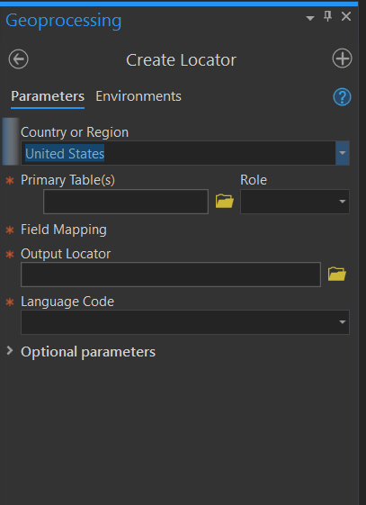
Creating an Address Locator
This is the dialog where you create your locator

Slide 31
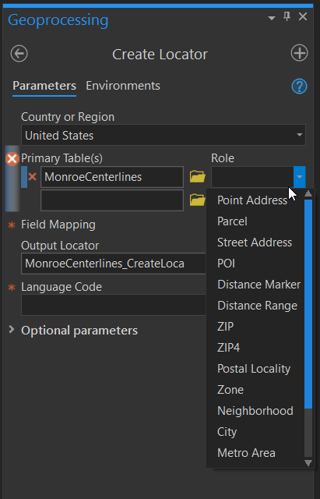
Creating an Address Locator
This is the dialog where you create your locator
Load the MonroeCenterlines as the Primary Table and Set the Role to Street Addresses

Slide 32
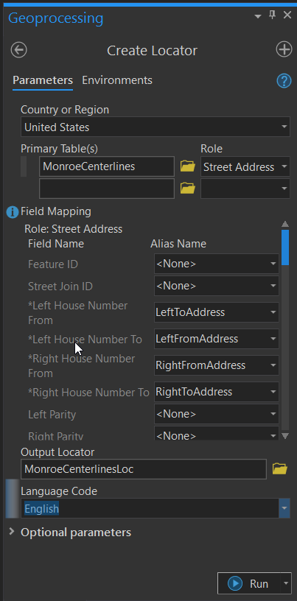
Creating an Address Locator
This is the dialog where you create your locator
Load the MonroeCenterlines as the Primary Table and Set the Role to Street Addresses
Match the Fields
Give it a output name
Set the Language to English

Slide 33
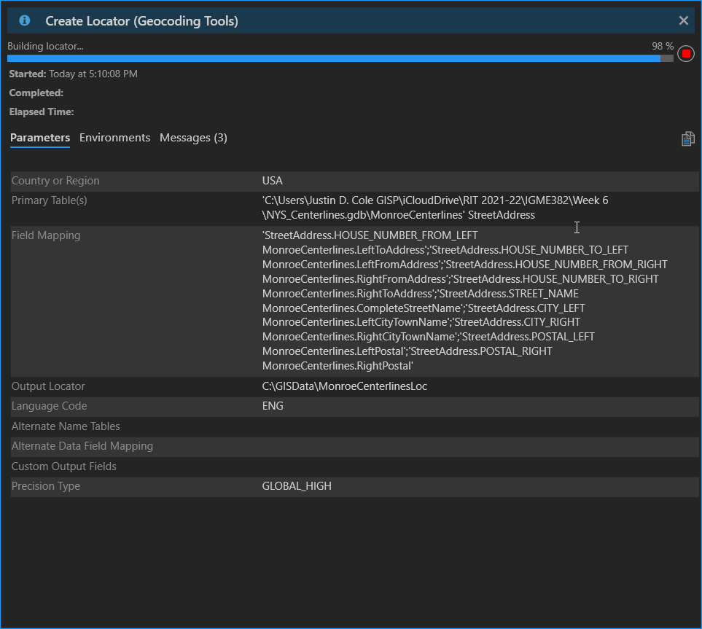
Creating an Address Locator
This is the dialog where you create your locator
Load the MonroeCenterlines as the Primary Table and Set the Role to Street Addresses
Match the Fields
Give it a output name
Set the Language to English

Slide 34
Creating an Address Locator
This is the dialog where you create your locator
Load the MonroeCenterlines as the Primary Table and Set the Role to Street Addresses
Match the Fields
Give it a output name
Set the Language to English

Slide 35
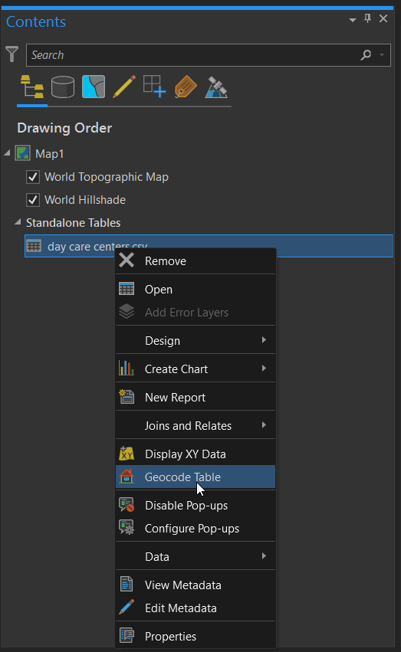
Add the Day Care Centers
From the downloads for this week save the day care centers table
Add the table to your workspace
Right click on the table and then geocode addresses

Slide 36
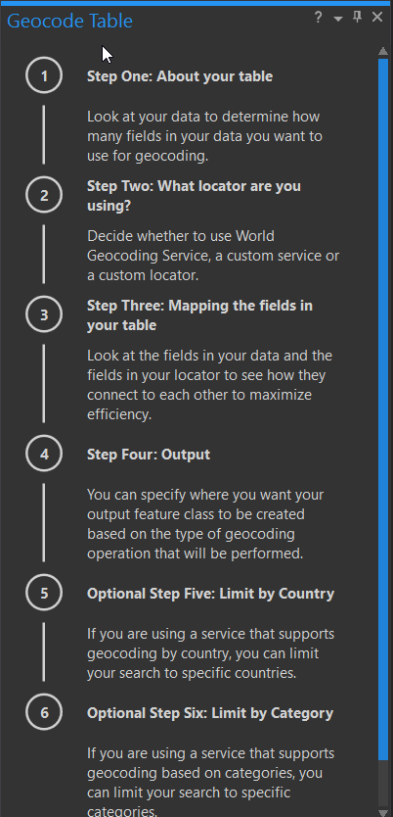
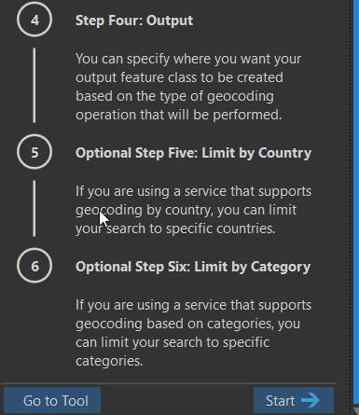
Geocoding the Day Cares
ArcGIS Pro has a nice workflow to follow
Click Start

Slide 37
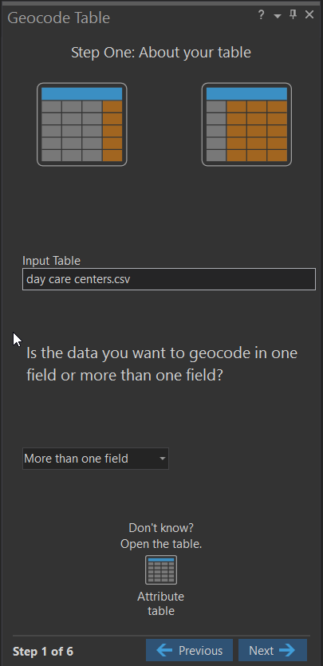
Geocoding the Day Cares
ArcGIS Pro has a nice workflow to follow
Click Start
Pick your table and if it has one field or multiple fields

Slide 38
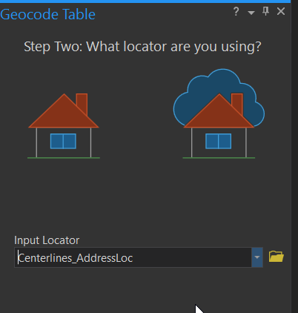
Geocoding the Day Cares
ArcGIS Pro has a nice workflow to follow
Click Start
Pick your table and if it has one field or multiple fields
Then your address locator

Slide 39
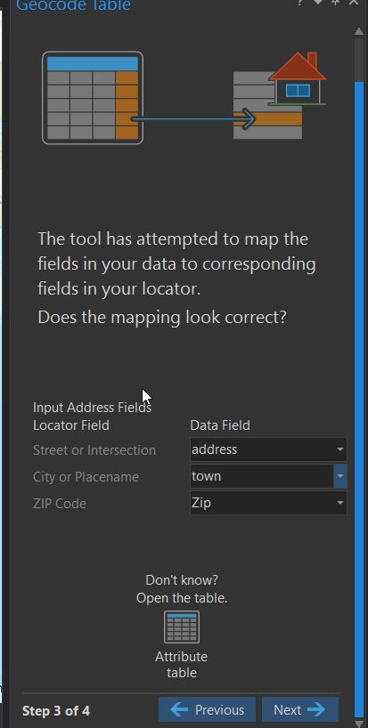
Geocoding the Day Cares
ArcGIS Pro has a nice workflow to follow
Click Start
Pick your table and if it has one field or multiple fields
Then your address locator
Then pick the fields

Slide 40
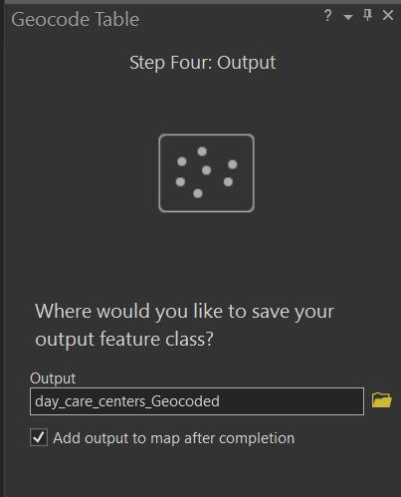
Geocoding the Day Cares
ArcGIS Pro has a nice workflow to follow
Click Start
Pick your table and if it has one field or multiple fields
Then your address locator
Then pick the fields
Lastly Give it a Name

Slide 41
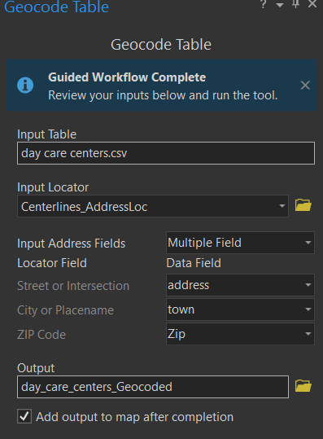
Geocoding the Day Cares
ArcGIS Pro has a nice workflow to follow
Click Start
Pick your table and if it has one field or multiple fields
Then your address locator
Then pick the fields
Lastly Give it a Name
(You get one last look of the settings before geocoding)

Slide 42
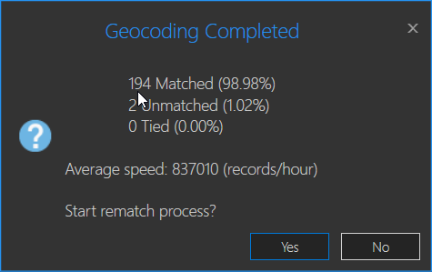
Fixing the Addresses
After you hit OK it will place the points
Depending on your data you will have to go in and clean up addresses
(Note PO Boxes will not geocode)

Slide 43
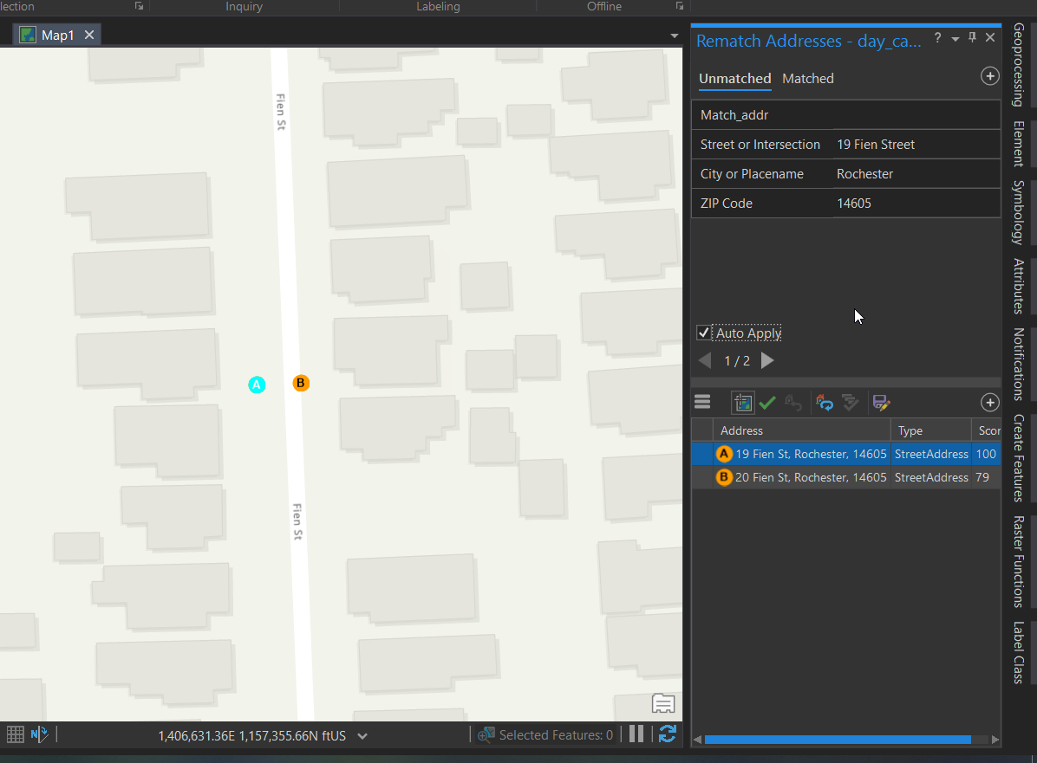
Review the Unmatched Addresses
Click Rematch
This brings up the geocoding review manager
On the top select unmatched addresses
Then you have to look at each one
Look at the possible list and manually pick the correct one
You can click zoom to candidates to get a better picture

Slide 44
Hands on Demo of Geocoding

Slide 45
Readings for Next Week
20101119_LDCMbrochure
Remote_Sensing_Feature_Articles
Landsat_Improve_Life1
Nex, Remondino - 2014 - UAV for 3D mapping applications A review
Remotesensing 08-00689

Slide 46
Lab 4 – GIS and Basic Map Making Due Date: September 30, 11:30 PM
Delivery Format: Word file in drop box Reminders:
Data is Lab4Data.zip

